Slide 1




WELCOME
In Our Group Project

Slide 2

KIET Group of Institutions, Ghaziabad
(An ISO – 9001: 2008 Certified & ‘A+’ Grade accredited Institution by NAAC)
PROJECT PRESENTATION
(Mini Project)
"PROJECT NAME – HOSTELHUB"

Slide 3





Problem Statement
New students face challenges in finding suitable accommodations due to location ambiguity, information deficiency, budgetary dilemmas, dining concerns, and security risks. Existing solutions lack an efficient location-based search, comprehensive data, and a balanced approach to budget constraints and amenities. Our project aims to address these issues by developing a user-friendly platform that enhances the accommodation search experience, providing precise location-based results, detailed information, and a secure environment for an informed decision-making process.

Slide 4


Introduction to Web Technologies : Frontend
Web technologies encompass HTML, CSS, and JS, which are the building blocks of modern websites. All three are used to create amazing web experiences.

Slide 5
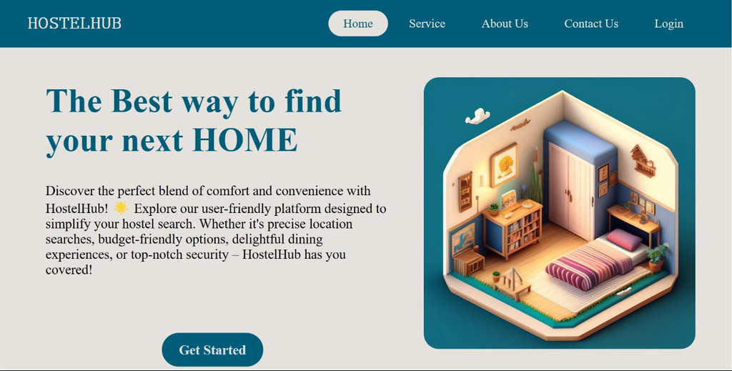

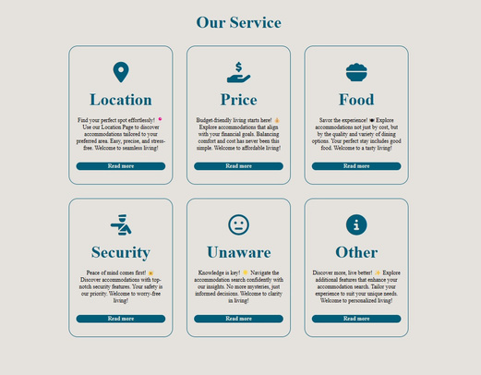
Hostelhub: Homepage
(HTML,CSS & JS)

Slide 6
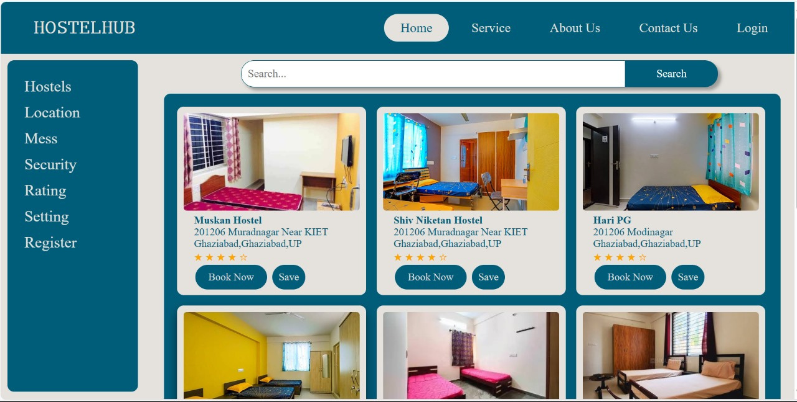
Hostelhub: Buy Page
(HTML,CSS & JS)

Slide 7
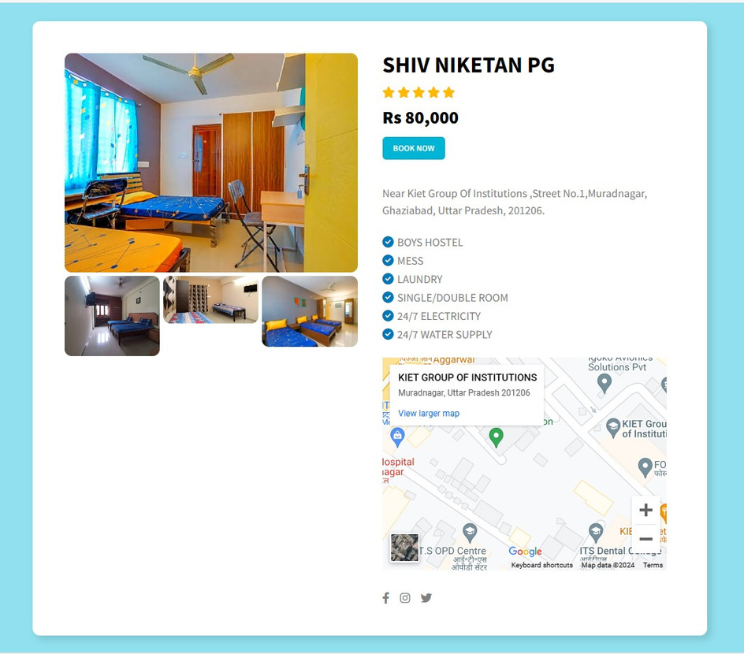
Hostelhub: Description Page
(HTML,CSS & JS)

Slide 8
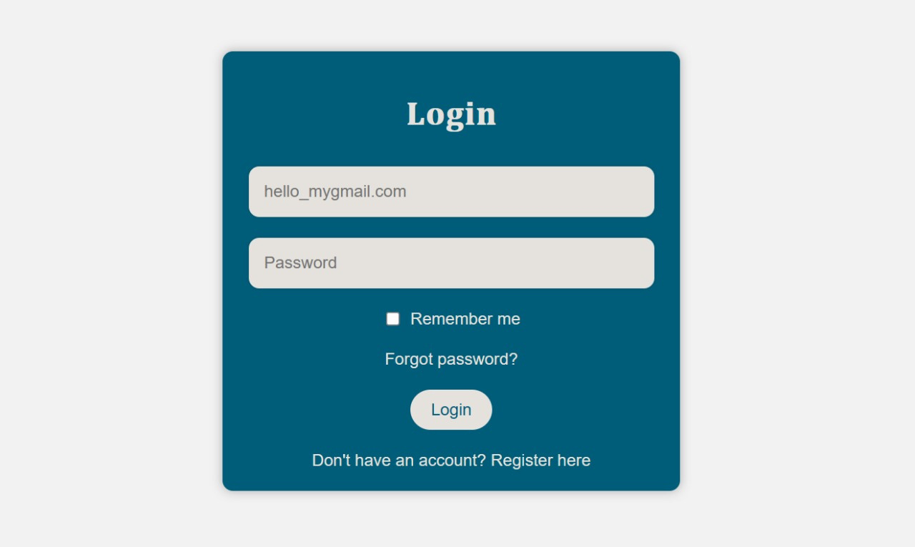
Hostelhub: Login Page
(HTML,CSS & JS)

Slide 9

Introduction to Web Technologies : Backend
MERN, comprising MongoDB, Express.js, React, and Node.js, forms a potent backend technology stack. MongoDB stores data, Express.js manages server-side logic, React crafts dynamic UIs, and Node.js ensures smooth server-client communication.

Slide 10
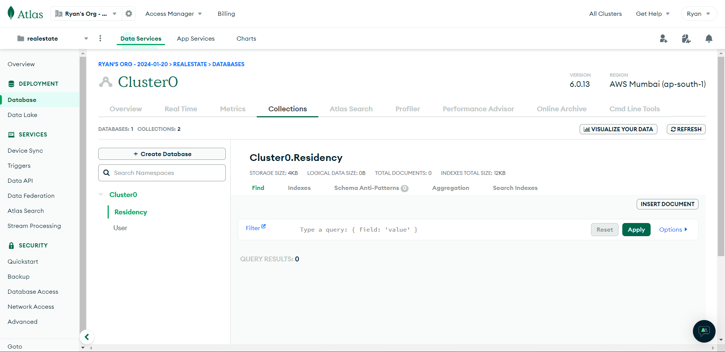
Hostelhub: Database

Slide 11
Key features of Hostelhub
1
Location Services
2
Affordable Prices
3
Food Options
4
Security Measures
5
User-Friendly Experience

Slide 12

﻿Meet The Group
Ryan Javed
(UI/UX+Frontend+Backend)
Puneet Kumar Singh
( Frontend)
Tarang Sharma
(Frontend)
Tushar Sharma
Content+UI/UX
Pankaj Chaudhary
Content+UI/UX
Rahul Kumar
Coordination
Rana Ayush
Coordination
Diya Bhatia
Mentor

Slide 13

Hostelhub
﻿THANK YOU

